Slide 1
CSS Grid
2D CSS layout

Slide 2
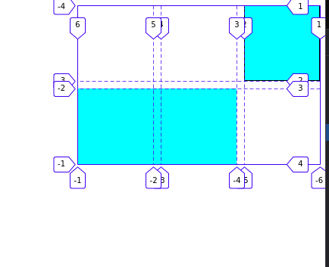
Defining grid
To define a grid use values of the display property `grid` or `inline-grid`. You can then create column and row tracks.
Browsers tools.
Grid-template properties.
Supports RTL.

Slide 3
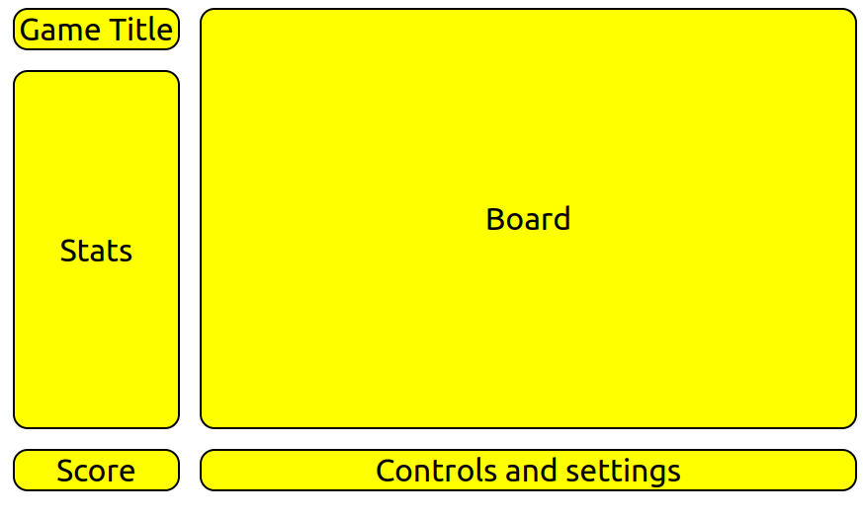
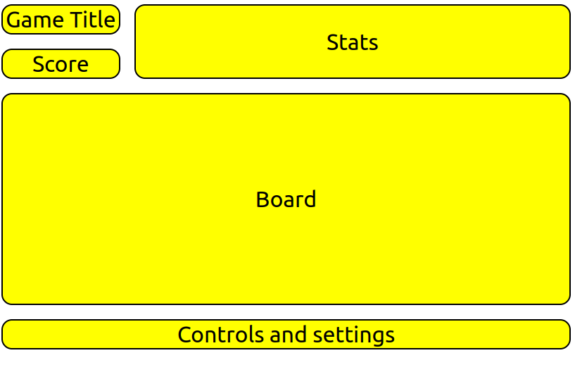
Redefining grid layout using media queries.
Span
Source order is independent.
Grid area names.
Diplay contents

Slide 4
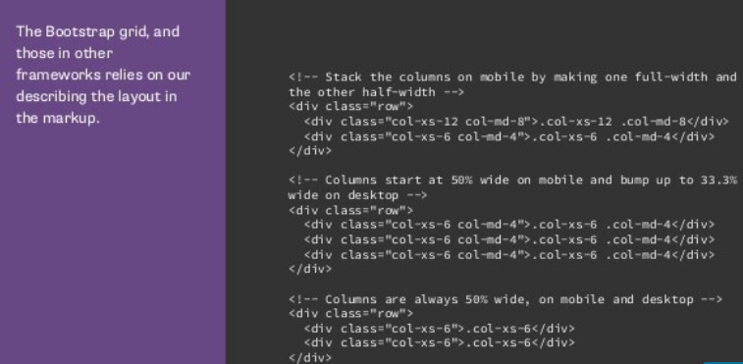
CSS Grid vs CSS Table.
Grid does no rely on content being in particular order.
Entirely defined in CSS. We can redifine grid at break points.
Framework grids vs CSS Grids.

Slide 5
Repeat
MinMax,
fr unit
auto-fit vs auto-fill in repeat function
Nested grids
Subgrids.
Margins and padding can be used on sub gridded items.

